Slide 1

Introduction to MS Teams
Lecture : 3
Advance Microsoft Office Programs

Slide 2
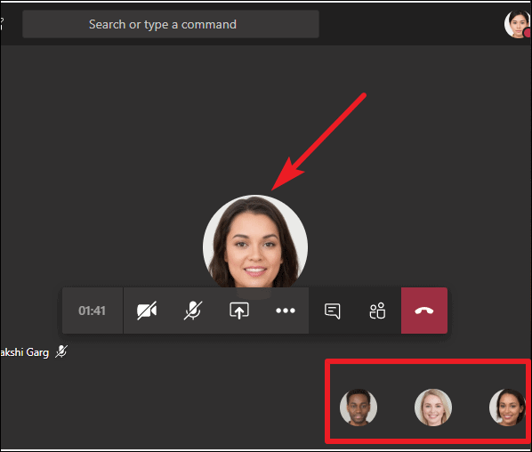
Features of MS Team
Use of Camera and Microphone
You will be presented with a start-up meeting screen. This allows you to configure your meeting
controls before you join the meeting.
At this stage you can choose whether or not to turn on your computer’s camera and microphone.

Slide 3
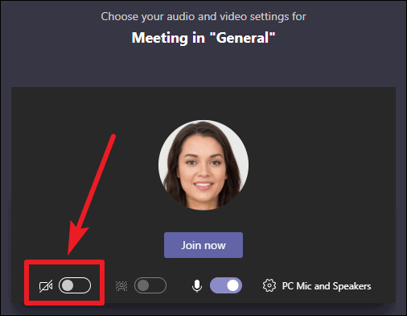
Features of MS Team
Use of Camera and Microphone
-Hover the mouse to the right and you will get ‘unmute
microphone’ and the mouse will change to a hand shape, click
right click mouse button.
-You can do the same for video
camera to be switched ‘on’ or ‘off’

Slide 4
Features of MS Team
Use of Camera and Microphone
If 3 or more people have already joined the meeting, you will be joining the meeting on mute. Select the slider to activate your microphone.

Slide 5
Features of MS Team
Use of Camera and Microphone
Select the “Audio Off” option when there’s already an active mic and speaker in the same room as you. This will ensure there is no echo.

Slide 6
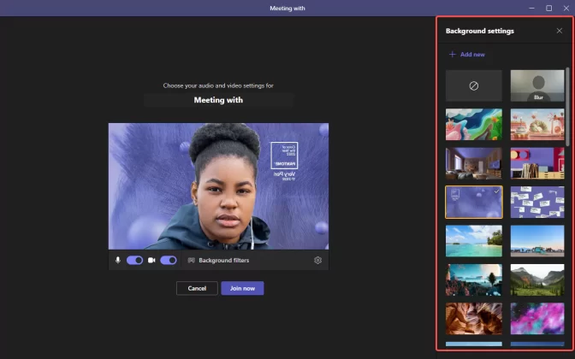
Features of MS Team
Background Filters
If you want to change what
appears behind you in your
video, you can either blur your
background or replace it
entirely with any image you
want.

Slide 7
Features of MS Team
Background Filters
If you want to change what
appears behind you in your
video, you can either blur your
background or replace it
entirely with any image you
want.

Slide 8
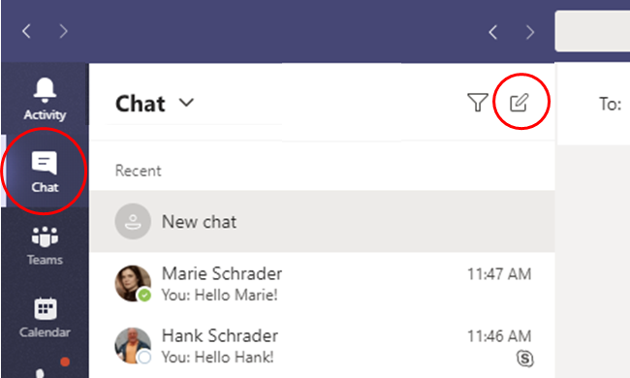
Features of MS Team
Use of Chat options
Click on ‘Chat’ and ‘New Chat’
Type in the email address of the
person you are sending a
message to or you can type their
name and select the recipient
from the list
When you receive a message this will be displayed with an alert.

Slide 9
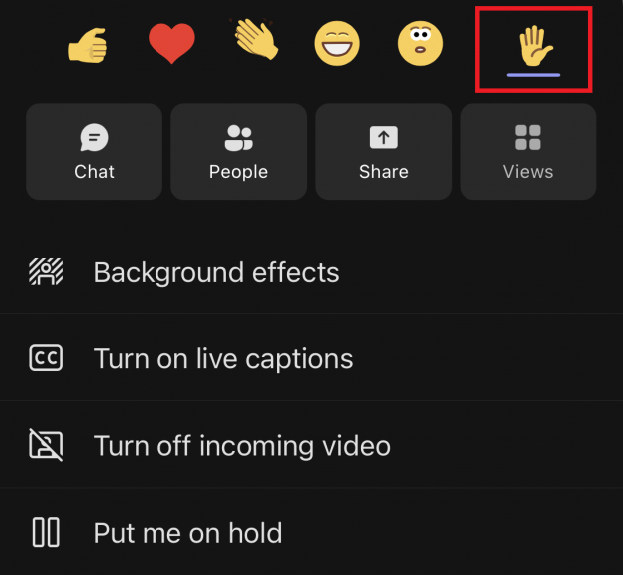
Features of MS Team
Raise/Lower Hand
During the meeting you can
click this icon to ‘raise your
hand’. This shows to the
teacher that you have digitally
raised your hand. This is useful
when you need to ask a
question.

Slide 10
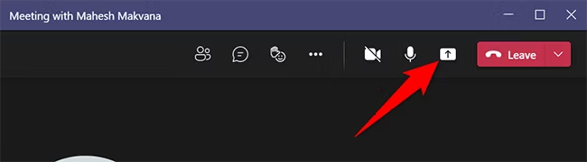
Features of MS Team
Share Screen
Select what you want to share:
▪ Desktop lets you show everything on your screen.
▪ Window lets you show a specific app.
▪ PowerPoint lets you show a presentation.
After you select what you want to show, a red border surrounds what you're sharing.

Slide 11
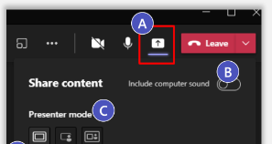
Features of MS Team
Share Screen
Select the Share Screen icon
Note the Include System Audio box is unchecked by default. Check when playing back video for meeting participants.
Select Presenter Mode options:
1. Content only
2. Standout (camera must be on)
3. Side by Side (camera must be on)

Slide 12
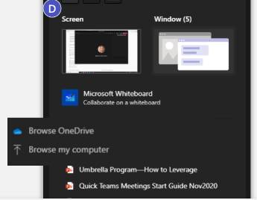
Features of MS Team
Share Screen
D. Select shared content:
Screen allows for sharing the screen in its entirety.
Window allows for sharing an app window.
PowerPoint Live allows for native PowerPoint presentation sharing.
Browse allows for browsing PowerPoint presentations.
Whiteboard allows for collaborative digital whiteboarding.

Slide 13
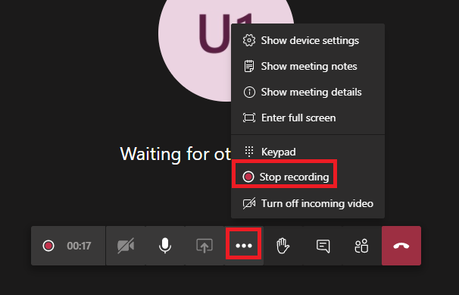
Features of MS Team
Record Meeting
Navigate to the More Actions... menu from within the Teams meeting window and select the Start recording option.
When the meeting has ended and you’d like to stop recording, select the Stop Recording option from the More Actions menu.

Slide 14
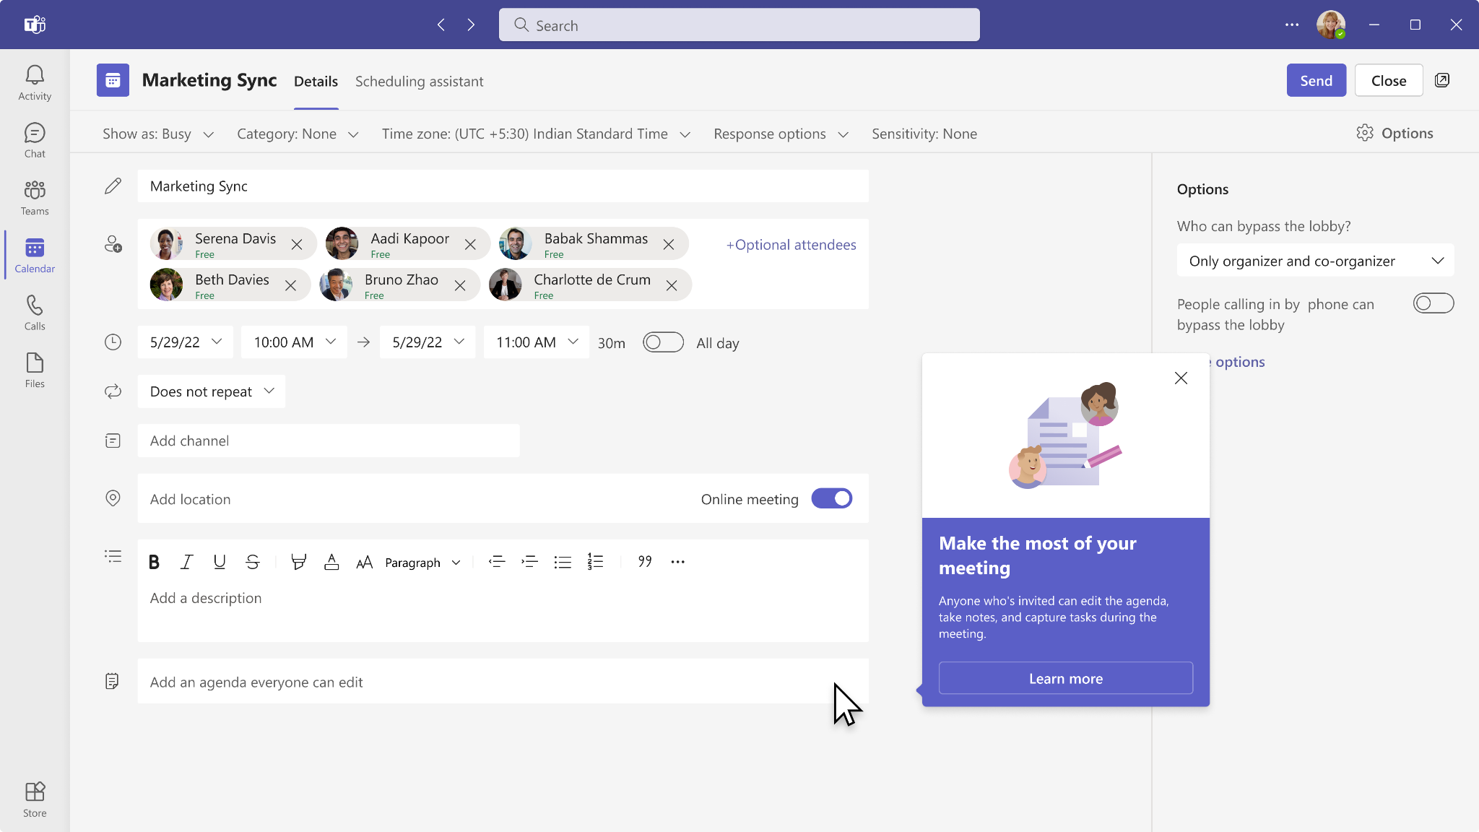
Features of MS Team
Collaborative meeting notes
The notes pane is always accessible by selecting the Meeting details icon in the control bar. Updates to collaborative meeting notes are reflected in real-time.
Select Open in OneNote from the meeting window, or browse to https://www.onenote.com/meetingnotes to see all your meeting notes. Click on a tile to open notes for that meeting.

Slide 15
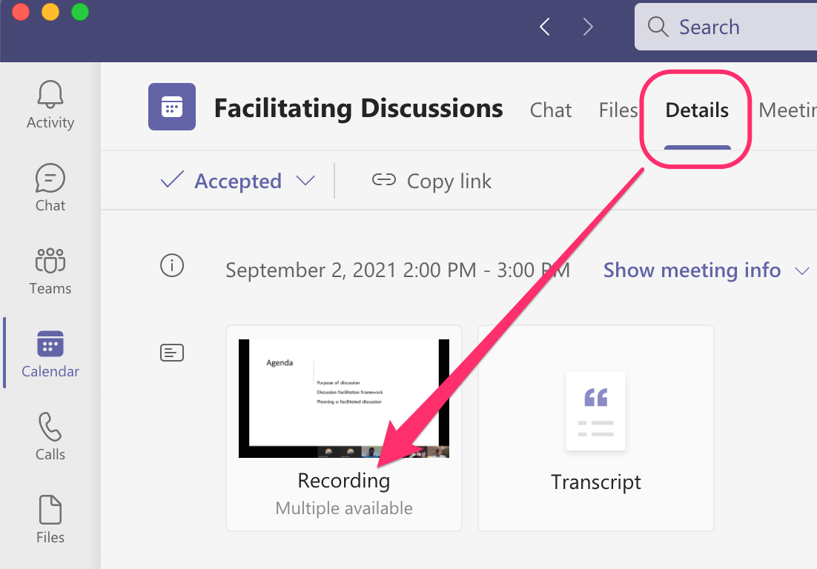
Features of MS Team
Sharing a recorded meeting
Navigate to the Chat app in the App Rail and select the meeting chat for your recent meeting.
Click the icon showing a preview of the meeting recording. This will launch a video player embedded in a browser window.
In the toolbar across the top of the window, click the Share option and type in the name(s) of the people you’d like to share access to the recorded meeting to. Click Send – they’ll receive an email notification.

Slide 16
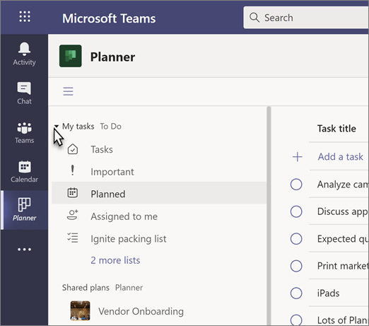
Features of MS Team
Assign and track action items
Navigate to the Teams app in the App Rail and click the + icon to create a new tab in the channel most relevant to your recent meeting.
Search for “Tasks” in order to locate the Tasks by Planner and To Do integration.
Type a descriptive name for your new plan in the Create a new plan field. You’ll now have a planner board, accessible to all team members.

Slide 17
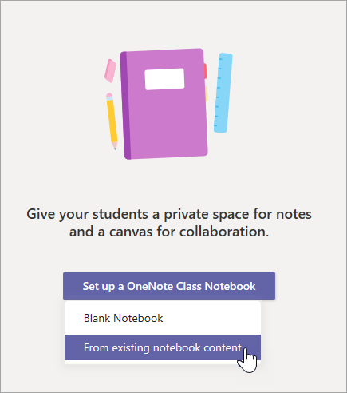
Features of MS Team
Using Class notebook
If your teacher asks you to work in your class notebook, click on ‘’Teams’’ during the call
Then select the correct subject/class
Finally, click on ‘’Class Notebook’’ where you will see the tasks you need to complete during or after the lesson

Slide 18
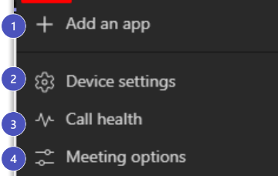
More Actions Icon
1. Add an app: Prior or during a meeting an App. Example:
Form/Breakthur/Kahoot
2.Device Settings: Select audio device and camera settings. Set restrictions to allow parties to move through shared presentations on their own.
3.Call Health: Identify Network, Audio, Video and Screen Sharing metrics.
4.Meeting Options: Customize settings for your meeting to determine how people join the meeting and who can present and manage meeting features..

Slide 19
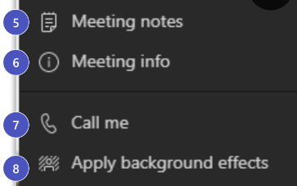
More Actions Icon
5. Meeting Notes: Notes you take are shared with others and are accessible before, during and after the meeting.
6.Meeting Info: Info Join meeting link info/ dial info.
7.Call Me: Me: Transfer meeting audio to a PSTN number.
8.Apply Background Effects:Apply blur background or apply a custom background so participants in the meeting are not distracted by what’s going on behind you when your camera is turned on.

Slide 20
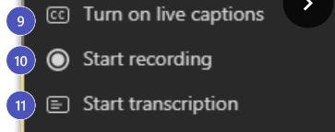
More Actions Icon
9.Turn On Live Captions: Live captions can make your meeting more inclusive to participants who are deaf or hard of hearing, people with different levels of language proficiency, and participants in a loud place.
10.Start Recording: When you record a meeting, a banner will appear, letting attendees know that the recording has begun. You can access the recording after the meeting
ends in the meeting chat or in Stream.
11.Start Transcription:Transcribe spoken conversations in meetings into text. Attendees can follow along to read the transcript live, much like they can with live captions. After
the meeting, conversations and outcomes are captured in the transcript and can be downloaded by everyone.

Slide 21
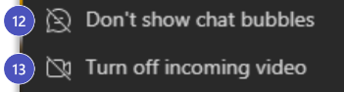
More Actions Icon
12.Don’t Show Chat Bubbles: Remove chat bubbles for less distraction on the screen.
13.Turn Off Incoming Video:Help the quality of the audio on incoming video by turning off video.

Slide 22
Choose your view and lock meeting
To change your view settings, select the view switcher icon in the upper-left corner.
By default, you will see gallery view which shows up to nine videos at once.
Once 10 people turn on their video you will have the option to turn on large gallery view, which shows up to 49 individual videos.
Together mode allows you to feel like you're in the same shared space with everyone in the meeting by digitally placing participants in a shared background.
Gallery on top mode displays all video feeds at the top of your meeting window, making it easier to have a more natural eye gaze with others.

Slide 23
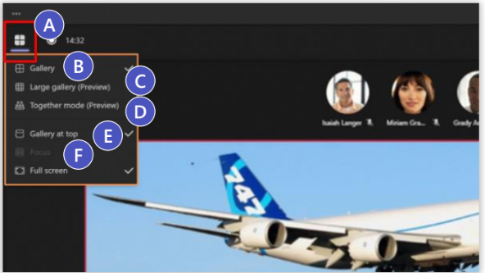
Choose your view and lock meeting
F. To get a better view of complex presentation materials or minimize distractions, turn on Focus mode. The shared content will fill the meeting window, and the meeting control bar remains at the top.

Slide 24
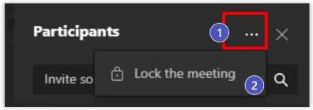
Choose your view and lock meeting
With the new Lock the meeting feature, as an organizer you can close
your meeting to any late-arriving attendees. Here's how:
Click the ellipses [...] for the More actions button in the upper right of the Participants panel.
Select Lock the meeting.

Slide 25
Use together mode
Participants can turn on together mode for themselves by selecting the More actions ellipses [...] on the meeting’s control bar, then select Together mode. Meeting participants with video on (up to 50) are displayed together, seated in the selected scene. Audio-only participants will continue to show beneath the main meeting stage.
To change the scene for everyone, the meeting organizer or a presenter can select Change scene in the lower left corner of the scene. Their selections will
be applied for all meeting participants.

Slide 26
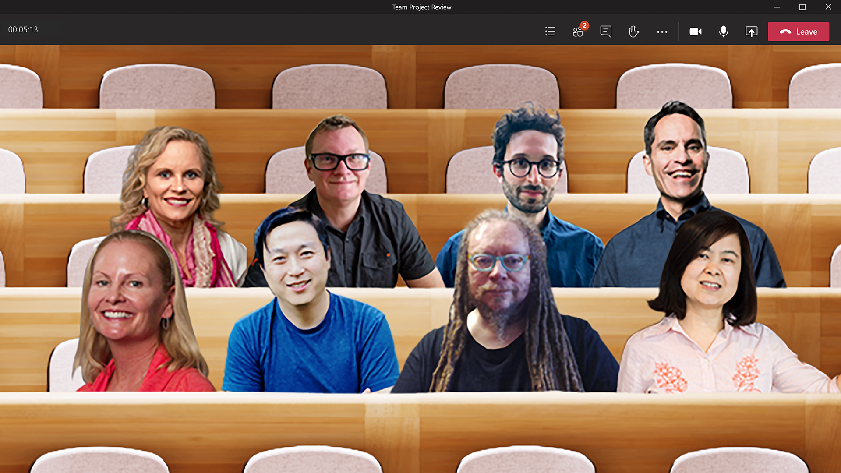
Use together mode
To turn off Together mode, select Gallery (up to nine videos in a 3x3 grid) or Large gallery (up to 49 videos in a 7x7 grid).

Slide 27
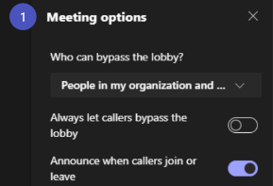
Managing participant settings
Configure meeting lobby
You can change settings for the meeting lobby before, during, and after the meeting.
Who can bypass the lobby?
Use the drop-down menu for lobby options.
**New option: People I invite, prevent forwarding invite.
Use the Always let callers bypass the lobby option to indicate whether people calling from a landline or mobile phone (PSTN calling) should wait in the lobby or not.

Slide 28
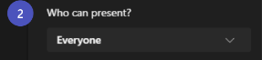
Managing participant settings
Set Participant Roles
Use the Who can present? Drop-down menu to define options available.
Change a participant’s role during the meeting:
Organizers and presenters can make changes while a meeting is in progress by selecting Show participants in the meeting controls. There, they can designate presenters and attendees.

Slide 29
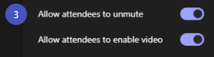
Managing participant settings
Allow attendees to unmute
If you toggle this setting to No, only the meeting organizer and presenters will be able to come off mute. Attendees will see a
tooltip stating, “Mic is disabled for all attendees.”
Note: Meeting organizers and presenters can now control whether attendees can unmute at any time during the meeting.

Slide 30
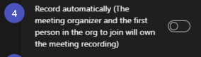
Managing participant settings
Record automatically
If you toggle this setting to Yes, recording starts when the meeting organizer and one other person join the meeting.

Slide 31
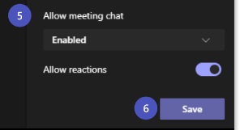
Managing participant settings
Allow meeting chat
Choose from three chat settings:
Enabled (Default): Anyone can chat before, during, and after the meeting.​
Disabled: No one (including the organizer) can chat before, during, or after the meeting.
Only during the meeting: Participants can only chat during the meeting. The organizer can chat before, during, and after the meeting.

Slide 32
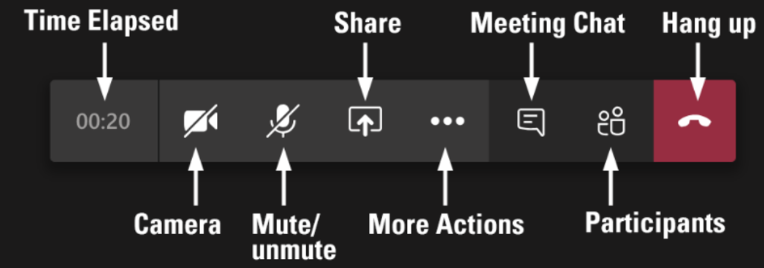
Summary of all control features

Slide 33

Let’s do some exercises!

Slide 34

Exercises
Join a meeting and practice turning your camera and microphone on and off.
Raise and lower your hand during a meeting
Share your screen during a meeting.
Send a message in the meeting chat.
Share a file in the meeting chat
Submit an assignment in a Teams class meeting
View a recorded meeting and share it with others
Assign and track action items during a meeting

Slide 35
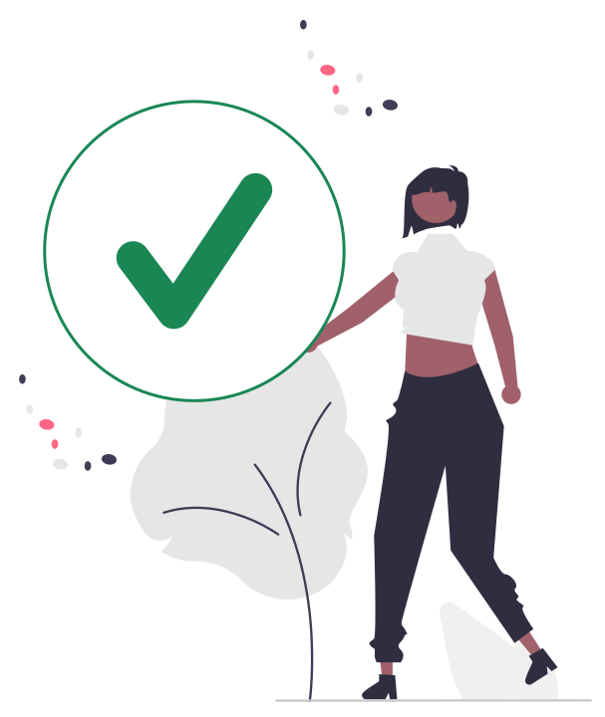
Thanks!

